Slide 1
CHAPTER 2
IMAGES
COLORS

Slide 2




DISCUSS
05 MIN
COLLECTIVE
What is the difference between
Analog data
Digital data
… and which of those 2 data is a “rounded data”?
Notes:
Analog Data: Data with values that change continuously, or smoothly, over time. Some examples of analog data include music, colors of a painting, or position of a printer during a race.
Digital Data: Data that changes discreetly through a finite set of possible values

Slide 3

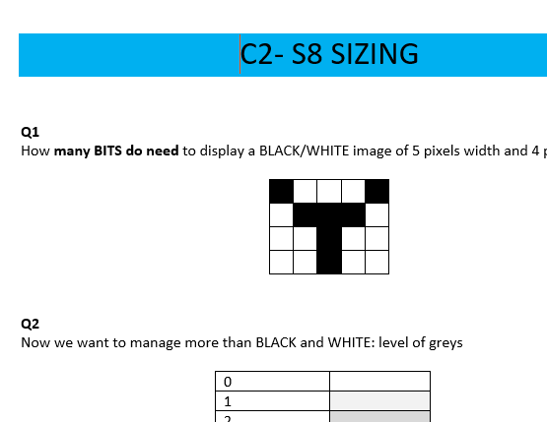
PRACTICE
SIZING EXERCICES (scored)
05 MIN
INDIV
Answers the 3 exercises, submit on google classroom

Slide 4

DISCUSS
05 MIN
GROUP 2
How many different shades of the color blue do you know?
How many do you think there are in total?

Slide 5
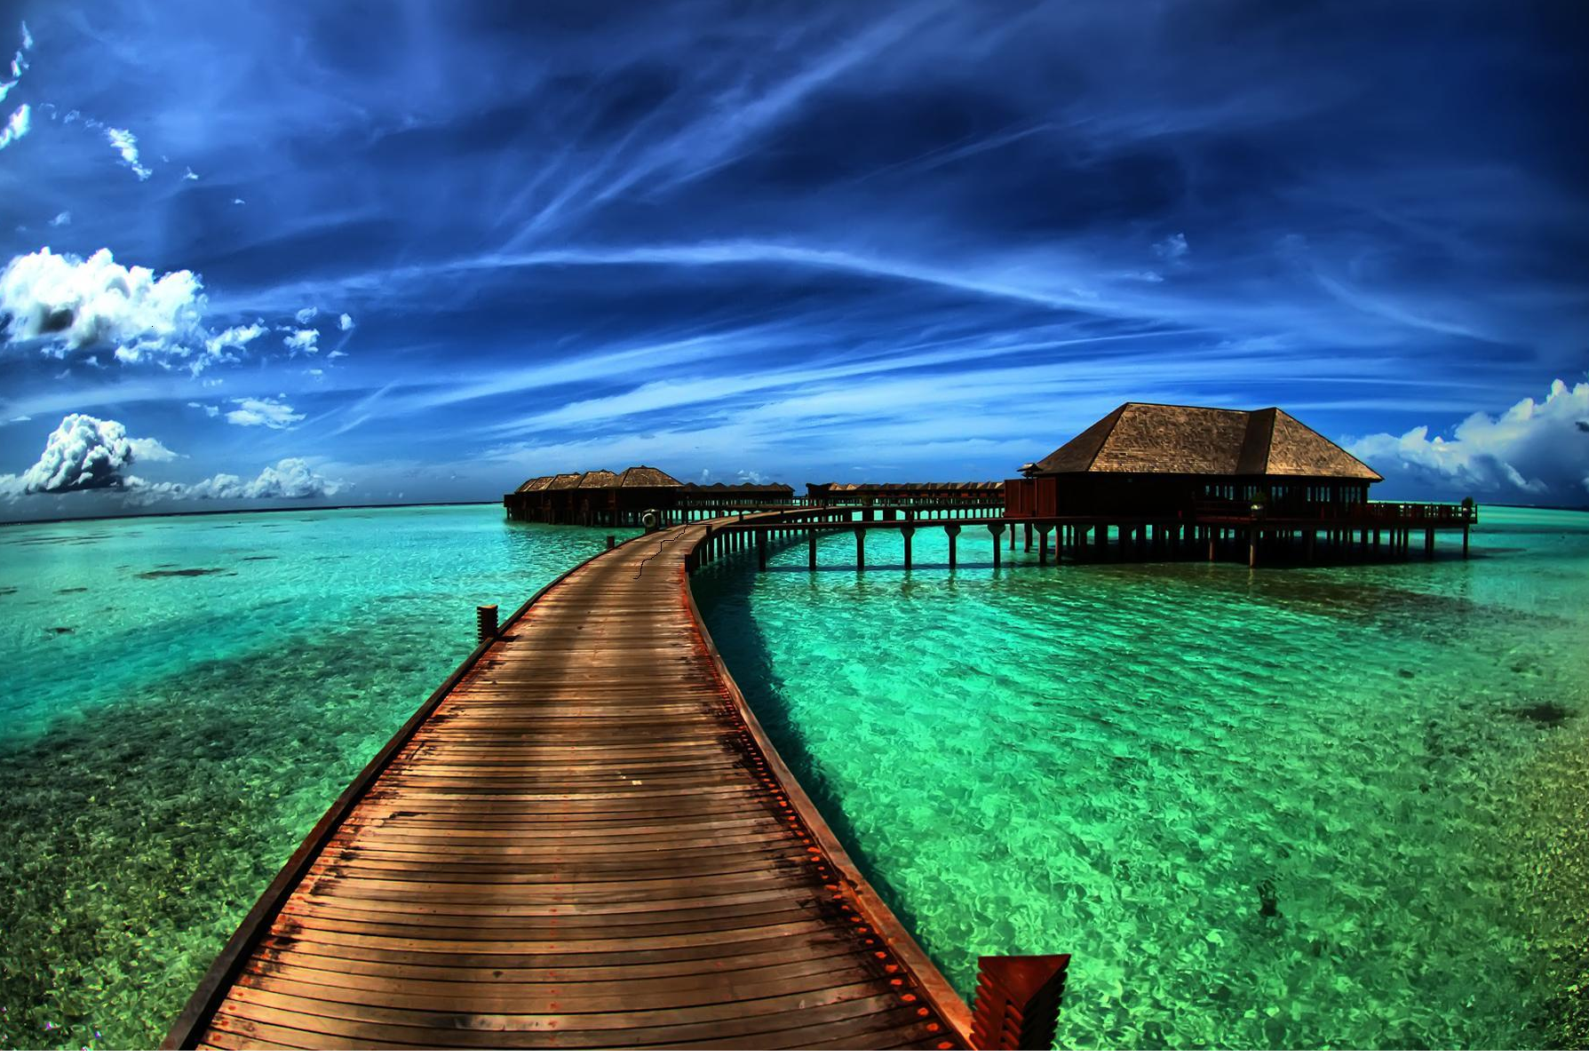
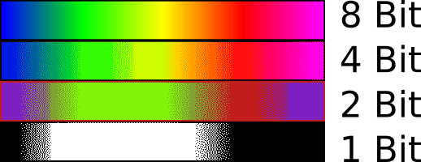
EXPLAIN
05 MIN
Real word produces
infinite shades of color
In digital word
color accuracy depends on your encoding

Slide 6
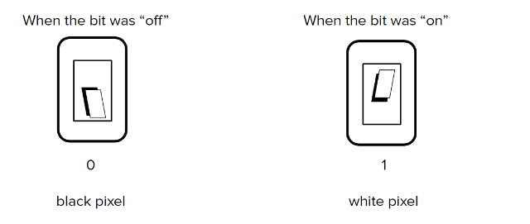
EXPLAIN
05 MIN
In Black/white image, each pixel is represented with 1 bit only:

Slide 7
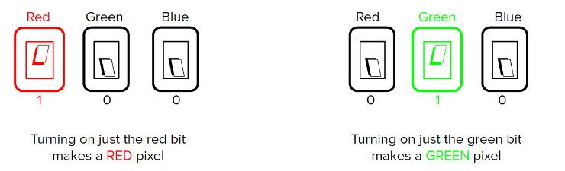
EXPLAIN
05 MIN
To express color, we can use 3 bit, as follows:

Slide 8
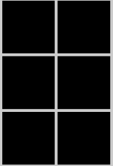

PRACTICE
Pixel editor - CHALLENGE 2
https://studio.code.org/s/csp1-2021/lessons/8/levels/2
15 MIN
INDIV
Create an image :
000 000
000 000
000 000
Width = 2 pixels
Height= 3 pixels
Bit per pixel = 3 bits
Change the values of each pixel to obtain the following 6 colors
??? ???
??? ???
??? ???
Explain why those color are obtained

Slide 9
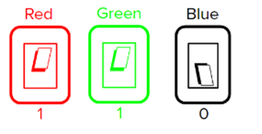

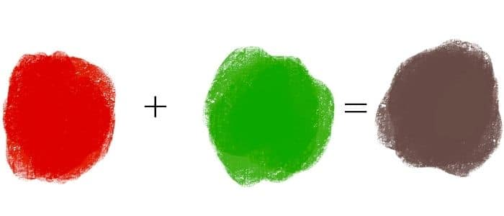
DISCUSS
05 MIN
Why do we get a YELLOW with RED + GREEN?
Why it’s different than what we get with paint colors?

Slide 10
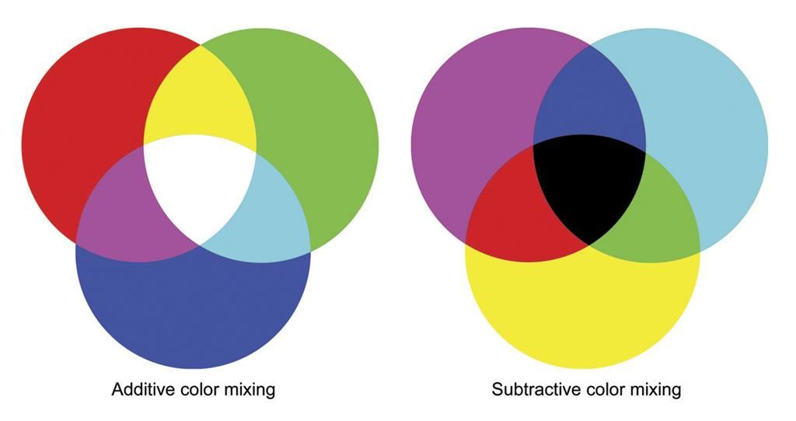


EXPLAIN
To way to mix colors
05 MIN
The additive way
Considers color as
Addition of energy (wavelengths )
The subtractive way
Considers color as
Filter of energy

Slide 11
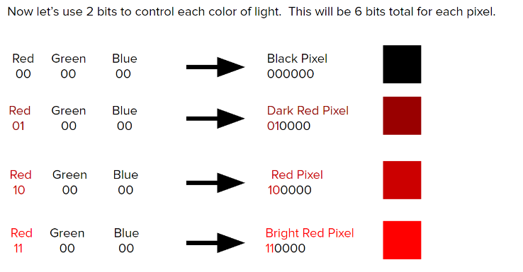
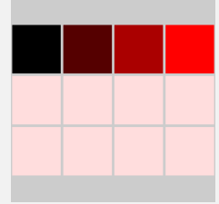
PRACTICE
Pixel editor - CHALLENGE 4
https://studio.code.org/s/csp1-2021/lessons/8/levels/4
15 MIN
INDIV
Now 6 bit per pixel :
Complete the image with shades
Of blue and green
Display shades of blue
Display shades of green

Slide 12
PRACTICE
Pixel editor - CHALLENGE 5
https://studio.code.org/s/csp1-2021/lessons/8/levels/5
15 MIN
INDIV
3 bits per color - 9 bit per pixel :
Complete the image with shades of blue and green
Display shades of blue
Display shades of green

Slide 13
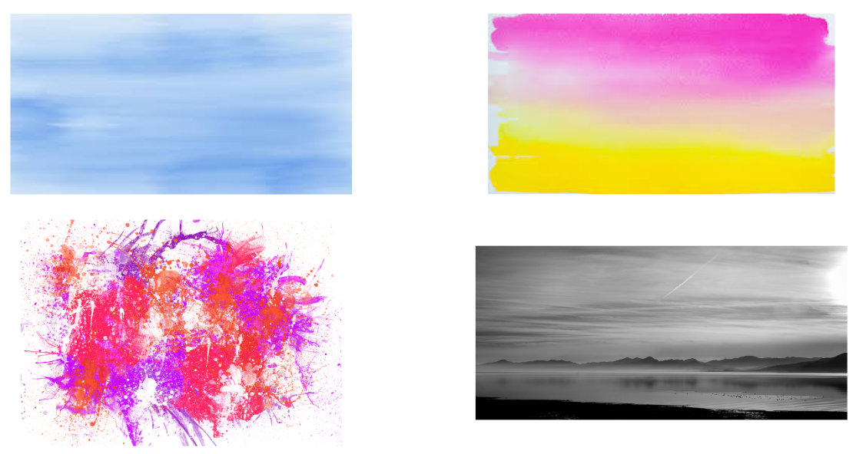
PRACTICE
Pixel editor - CHALLENGE 6
https://studio.code.org/s/csp1-2021/lessons/8/levels/6
15 MIN
INDIV
Reproduce 1 of the 4 image bellow with the pixel editor
2. Answer question:
Which image size did you choose?
Which color model did you choose

Slide 14

HOMEWORK
INDIV
RESEARCH HOMEWORK
In RGB model, we express each color (R, G, B) with values between 0 and 255.
https://www.w3schools.com/colors/colors_rgb.asp
Research how to convert an RGB color (8 bits per color) to hexadecimal
Be ready to present it to the class, by giving examples !

